Slide 1

Delay Prediction in Supply Chains: A Hybrid Graph-Based and Machine Learning Approach
Candidate: Volpato Mattia
Supervisor: Prof. Michele Ciavotta
Company Co-Supervisor: Eng. Bruno Puzzolante
Master degree
Computer Science

Slide 2
Agenda
M4ESTRO Project Overview
Background & Context
Motivation & Purpose Key Contributions
Dataset & External Sources
Pilot and Tracking data
Traffic, Weather and Holiday data
Supply Chain Modeling
Supply Chain Graph Model
Markov Chain Routing Model
Paths Extraction and Probability Distributions
Historical Indicators
Definition
Implementation
Realtime Indicators
Overview
Definition
Implementation
Protoype & Results
Prototype Architecture
Evaluation Methodology
Quantitative Evaluation
Sensitivity Analysis
Evolution of Shipment Estimates
Conclusion
Key Findings
Future Developments

Slide 3
M4ESTRO Project Overview

Slide 4

Background & Context
M4ESTRO Project OVERVIEW
Disruptions are reshaping the manufacturing industry, revealing global supply chain vulnerabilities and highlighting the critical need for resilience.
Supply Chain Challenges
Global disruptions (pandemics, conflicts, climate events) expose supply chain fragility.
Rising disruption frequency and severity create volatile, uncertain, complex, and ambiguous (VUCA) conditions.
Resilience and adaptability are essential for continuity and competitiveness.

Slide 5



M4ESTRO – A Horizon Europe Project
M4ESTRO Project OVERVIEW
Project Goals
Consortium and Scope
Strategic Pillars
Develop a resilient, transparent, and adaptive ecosystem under the Manufacturing-as-a-Service (MaaS) paradigm, enhancing supply chain flexibility and robustness.
Consortium of 18 partners from 8 countries, including industrial pilots, technology providers, and research institutions, collaborating over 42 months.
Four pillars support M4ESTRO: resilient manufacturing processes, AI-enabled adaptive equipment, industrial metaverse simulations and human-centered sustainability and resilience.

Slide 6
Research Motivation & Purpose
M4ESTRO Project OVERVIEW
M4ESTRO - Industrial Manufacturing As a sErvice STRategies and models for flexible, resilient, and re-configurable value networks through Trusted and Transparent Operations
Motivation
Purpose
Global disruptions (pandemics, conflicts, climate events) expose supply chain fragility.
Rising disruption frequency and severity create volatile, uncertain, complex, and ambiguous (VUCA) conditions.
Resilience and adaptability are essential for continuity and competitiveness.
M4ESTRO introduces the concept of disruption indicator:
Monitor the operational dynamics of the supply chain.
Detect anomalies in real time across logistics systems.
Quantify the impact of disruptions using interpretable data-driven metrics.
Enable timely responses through integration with decision-support tools.

Slide 7
Key Contributions
This work addresses Task 1.2, focusing on the design of Logistics Chain Disruption Indicators (LCDIs) for detecting internal disruptions.
It concentrates on a subset of LCDIs aimed at estimating delivery times and delays within a single-manufacturer supply chain.
M4ESTRO Project OVERVIEW
Supply chain modeling
Mathematical framework for modeling a single-manufacturer supply chain.
Indicators Design and Implementation
Logistics Chain Disruption Indicators (LCDIs) to quantify:
Dispatch and shipment process durations.
Real-time traffic and weather impacts on shipments.
Effect of national holidays on dispatch processes.
Prototype development and deployment
Prototype using pilot partner data deployed on AWS cloud infrastructure.

Slide 8
Dataset & External Sources

Slide 9



Pilot and Tracking Data
Dataset & EXTERNAL SOURCES
Pilot Order Data
Carrier Tracking Data
Geographical Data
FAE Technology, core dataset provider: one-hundred order records with supplier locations, timestamps and tracking links.
17Track API to retrieve shipment events across multiple carriers, including location, timestamp, and status.
Geonames API to standardize shipment events and supplier locations at a city level.
Three sources forming the core dataset, providing the foundational data that captures the supply chain structure.

Slide 10





Traffic, Weather and Holiday Data
Dataset & EXTERNAL SOURCES
Traffic Data
Weather Data
Holiday Data
TomTom API to retrieve road traffic data, comparing ideal vs real-time conditions between two locations.
Visual Crossing API to retrieve weather data, providing real-time conditions for any location.
Calendarific API to retrieve national holidays worldwide, providing indications on supplier closures.
Three complementary sources enrich the core dataset, providing a complete representation of the supply chain.

Slide 11
Supply Chain Modeling

Slide 12
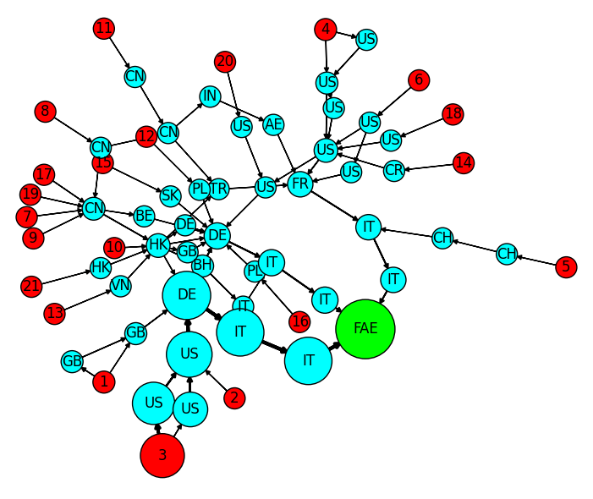
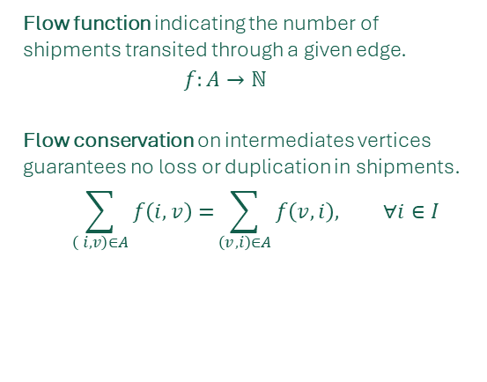
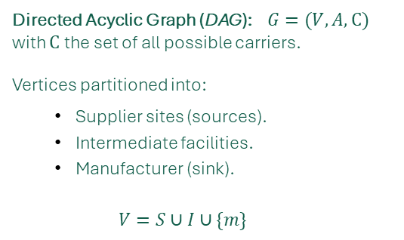
Supply Chain Graph Model
Supply CHAIN Modeling
Graph Structure
Directed Acyclic Graph (DAG): $G=(V, A,C)$ with $C$ the set of all possible carriers.
Vertices partitioned into:
Supplier sites (sources).
Intermediate facilities.
Manufacturer (sink).
$$V=S∪I∪\{m\}$$
Shipments Flow
Flow function indicating the number of shipments transited through a given edge.
$$f:A→ℕ$$
Flow conservation on intermediates vertices guarantees no loss or duplication in shipments.
$$\sum_{\left( i, v\right)∈A}{f\left(i,v\right)=}\sum_{\left(v, i\right)∈A}{f\left(v,i\right), ∀i∈I}$$
Supplier sites
Intermediate locations
Manufacturer

Slide 13
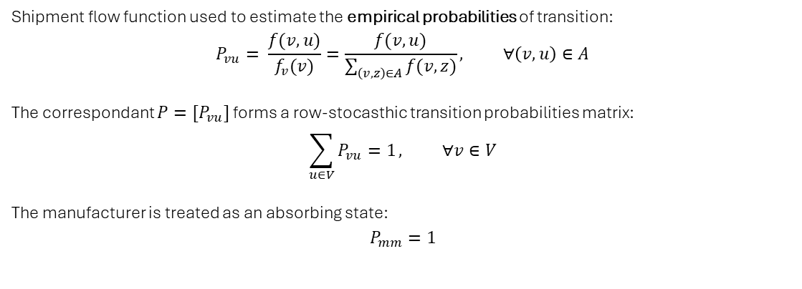
Markov Chain Routing Model (1)
Supply CHAIN Modeling
Empirical Probabilities
Shipment flow function used to estimate the empirical probabilities of transition:
$$P_{vu}= \frac{f(v,u)}{f_{v}(v)}=\frac{f(v,u)}{\sum_{\left(v,z\right)∈A}{f(v,z)}}, ∀\left(v,u\right)∈A$$
The correspondant ${P=[P}_{vu}]$ forms a row-stocasthic transition probabilities matrix:
$$\sum_{u∈V}{P_{vu}=1}, ∀v∈V$$
The manufacturer is treated as an absorbing state:
$$P_{mm}=1$$
Shipments are represented as maximal paths ending in the manufacturer. The routing process is modeled using discrete-time Markov chains, capturing shipment trajectories as stochastic processes based on empirical transition probabilities derived from historical shipment flows.

Slide 14
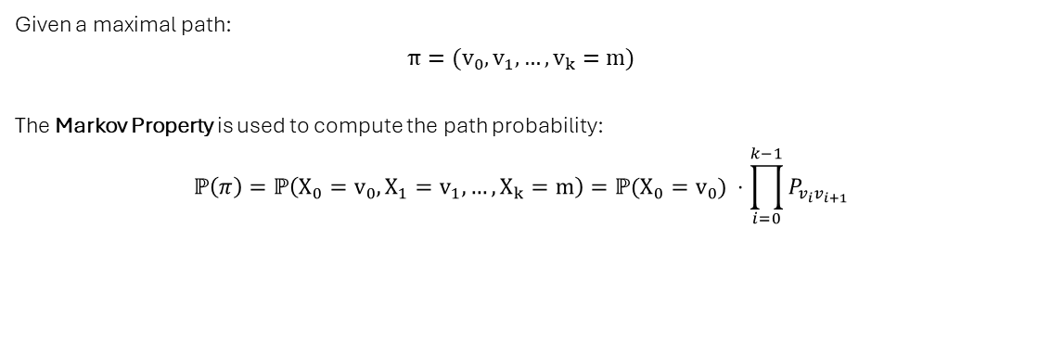
Markov Chain Routing Model (2)
Supply CHAIN Modeling
Probabilistic Routing
Given a maximal path:
$$π={(v}_{0},v_{1}, …,v_{k}=m)$$
The Markov Property is used to compute the path probability:
$$ℙ\left(π\right)=ℙ\left(X_{0}=v_{0},X_{1}=v_{1}, …,X_{k}=m\right)=ℙ(X_{0}=v_{0}) ⋅\prod_{i=0}^{k−1}{P_{v_{i}v_{i+1}}}$$
Shipments are represented as maximal paths ending in the manufacturer. The routing process is modeled using discrete-time Markov chains, capturing shipment trajectories as stochastic processes based on empirical transition probabilities derived from historical shipment flows.

Slide 15
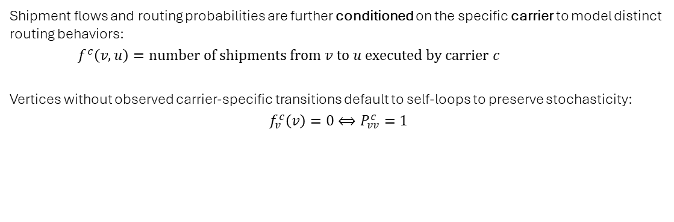
Markov Chain Routing Model (3)
Supply CHAIN Modeling
Carrier-Conditioned Dynamics
Shipment flows and routing probabilities are further conditioned on the specific carrier to model distinct routing behaviors:
$f^{c}\left(v,u\right)=number of shipments from v to u executed by carrier c$
Vertices without observed carrier-specific transitions default to self-loops to preserve stochasticity:
$$f_{v}^{c}\left(v\right)=0⟺P_{vv}^{c}=1$$
Shipments are represented as maximal paths ending in the manufacturer. The routing process is modeled using discrete-time Markov chains, capturing shipment trajectories as stochastic processes based on empirical transition probabilities derived from historical shipment flows.

Slide 16
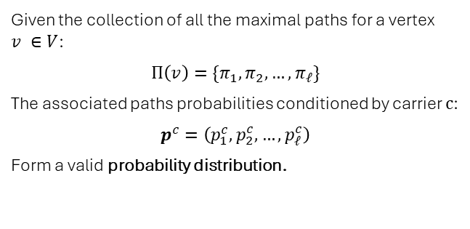
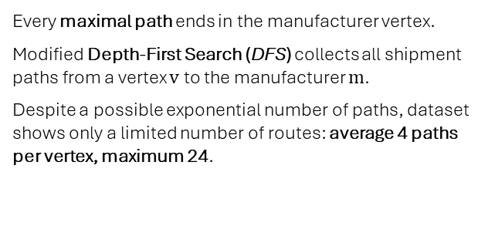
Paths Extraction and Probability Distributions
Supply CHAIN Modeling
1. Paths Extraction Methodology
2. Probability Distribution Computation
Every maximal path ends in the manufacturer vertex.
Modified Depth-First Search (DFS) collects all shipment paths from a vertex $v$ to the manufacturer $m$.
Despite a possible exponential number of paths, dataset shows only a limited number of routes: average 4 paths per vertex, maximum 24.
Given the collection of all the maximal paths for a vertex $v ∈V$:
$$Π\left(v\right)=\{π_{1},π_{2},…,π_{ℓ}\}$$
The associated paths probabilities conditioned by carrier $c$:
$$p^{c}=\left(p_{1}^{c},p_{2}^{c},…,p_{ℓ}^{c}\right)$$
Form a valid probability distribution.
For each vertex, carrier behavior is modeled by considering all possible paths to the manufacturer, along with the probability that each path is followed.

Slide 17
Historical Indicators

Slide 18
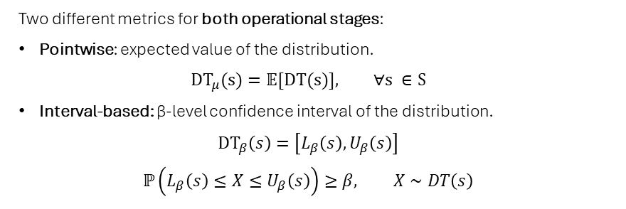
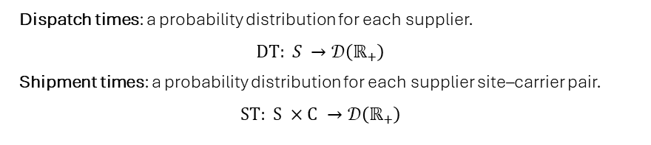
Historical Indicators Definition
HISTORICAL Indicators
Time Probability Distributions
Dispatch process: from order placement to shipment start.
Shipment process: from shipment start to delivery.
Delivery process: combination of dispatch and shipment processes.
Dispatch times: a probability distribution for each supplier.
$$DT: S →𝒟\left(ℝ_{+}\right)$$
Shipment times: a probability distribution for each supplier site–carrier pair.
$$ST: S ×C →𝒟\left(ℝ_{+}\right)$$
Historical indicators are stastistical measures that characterize key operational times in the order fulfillment process, based exclusively on historical data.
Statistical Metrics
Two different metrics for both operational stages:
Pointwise: expected value of the distribution.
$$DT_{μ}(s)=𝔼[DT(s)], ∀s ∈S$$
Interval-based: β-level confidence interval of the distribution.
$$DT_{β}\left(s\right)=\left[L_{β}\left(s\right),U_{β}\left(s\right)\right]$$
$$ℙ\left(L_{β}\left(s\right)≤X≤U_{β}\left(s\right)\right)≥β, X∼DT\left(s\right)$$

Slide 19
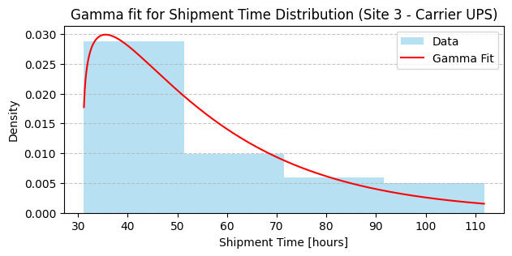
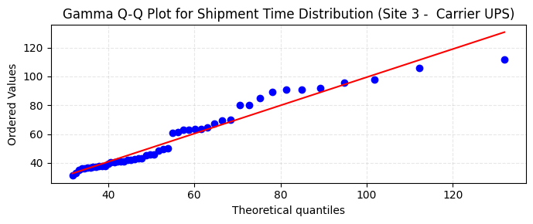
Historical Indicators Implementation
HISTORICAL INDICATORS
Theoretical Distribution
Fitting Procedure
Gamma distributions chosen for their established use in supply-chain literature.
Parameter estimation via Maximum Likelihood Estimation.
Data threshold: Samples with ≥30 observations.
Outlier removal: Interquartile Range (IQR) method. Goodness-of-fit checks: Q–Q plots and histograms. Statistical validation: Bootstrap Kolmogorov–Smirnov tests show no evidence against the Gamma assumption.

Slide 20
Realtime Indicators

Slide 21
Realtime Indicators Overview
Realtime indicators are statistical measures that provide actionable insights into the current state of the supply chain.
Organized hierarchically at different granularity levels, they combine:
Historical indicators.
Supply chain graph.
Real-time data.
Realtime indicators from lower levels.
Realtime Indicators
Realtime Indicators Hierarchy
Granularity | Scope
Vertex | Supplier and carrier facility.
Route | Carrier route between two locations.
Path | Supplier to manufacturer carrier path.
Graph | Overall supply chain network.

Slide 22
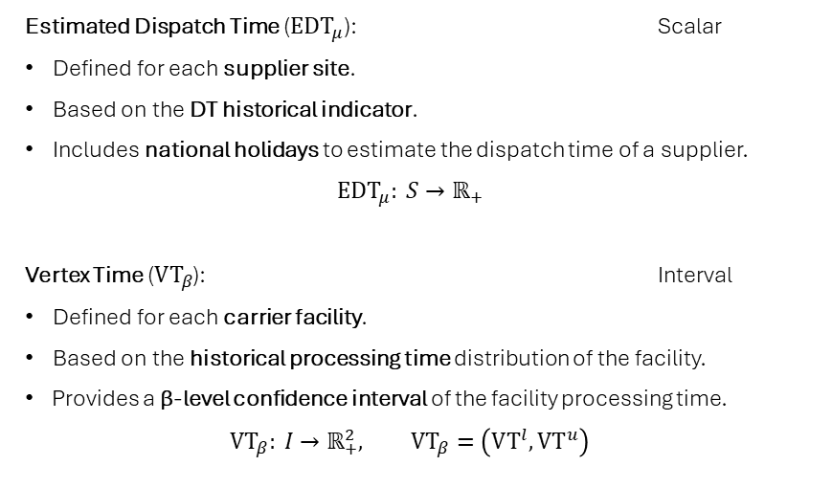
Realtime Indicators Definition (1)
Realtime indicators are statistical measures that provide actionable insights into the current state of the supply chain.
Organized hierarchically at different granularity levels, they combine:
Historical indicators.
Supply chain graph.
Real-time data.
Realtime indicators from lower levels.
Realtime Indicators
Vertex Level
Estimated Dispatch Time ($EDT_{μ}$): Scalar
Defined for each supplier site.
Based on the DT historical indicator.
Includes national holidays to estimate the dispatch time of a supplier.
$$EDT_{μ}: S→ℝ_{+}$$
Vertex Time ($VT_{β}$): Interval
Defined for each carrier facility.
Based on the historical processing time distribution of the facility.
Provides a β-level confidence interval of the facility processing time.
$$VT_{β}: I→ℝ_{+}^{2}, VT_{β}=\left(VT^{l},VT^{u}\right)$$

Slide 23
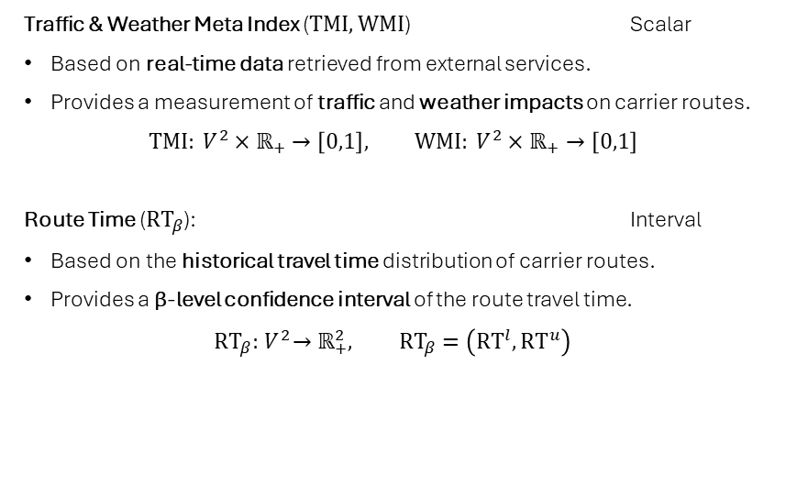
Realtime Indicators Definition (2)
Realtime indicators are statistical measures that provide actionable insights into the current state of the supply chain.
Organized hierarchically at different granularity levels, they combine:
Historical indicators.
Supply chain graph.
Real-time data.
Realtime indicators from lower levels.
Realtime Indicators
Route Level
Traffic & Weather Meta Index ($TMI, WMI$) Scalar
Based on real-time data retrieved from external services.
Provides a measurement of traffic and weather impacts on carrier routes.
$$TMI: V^{2}×ℝ_{+}→\left[0,1\right], WMI: V^{2}×ℝ_{+}→\left[0,1\right]$$
Route Time ($RT_{β}$): Interval
Based on the historical travel time distribution of carrier routes.
Provides a β-level confidence interval of the route travel time.
$$RT_{β}:{ V}^{2}→ℝ_{+}^{2}, RT_{β}=\left(RT^{l},RT^{u}\right)$$

Slide 24
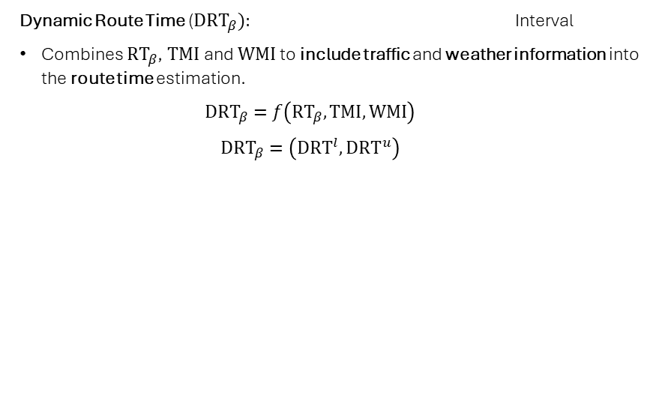
Realtime Indicators Definition (3)
Realtime indicators are statistical measures that provide actionable insights into the current state of the supply chain.
Organized hierarchically at different granularity levels, they combine:
Historical indicators.
Supply chain graph.
Real-time data.
Realtime indicators from lower levels.
Realtime Indicators
Route Level
Dynamic Route Time (${DRT}_{β}):$ Interval
Combines $RT_{β}$, $TMI$and $WMI$ to include traffic and weather information into the route time estimation.
$${DRT}_{β}=f\left(RT_{β},TMI,WMI\right)$$
$$DRT_{β}=\left(DRT^{l},DRT^{u}\right)$$

Slide 25
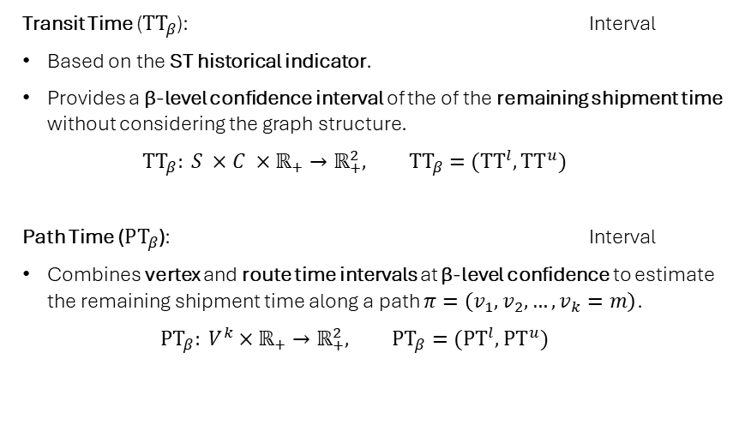
Realtime Indicators Definition (4)
Realtime indicators are statistical measures that provide actionable insights into the current state of the supply chain.
Organized hierarchically at different granularity levels, they combine:
Historical indicators.
Supply chain graph.
Real-time data.
Realtime indicators from lower levels.
Realtime Indicators
Path Level
Transit Time ($TT_{β}$): Interval
Based on the ST historical indicator.
Provides a β-level confidence interval of the of the remaining shipment time without considering the graph structure.
$$TT_{β}: S ×C ×ℝ_{+}→ℝ_{+}^{2}, TT_{β}=(TT^{l},TT^{u})$$
Path Time ($PT_{β}$): Interval
Combines vertex and route time intervals at β-level confidence to estimate the remaining shipment time along a path $π=\left(v_{1},v_{2},…,v_{k}=m\right)$.
$$PT_{β}: V^{k}×ℝ_{+}→ℝ_{+}^{2}, PT_{β}=(PT^{l},PT^{u})$$

Slide 26
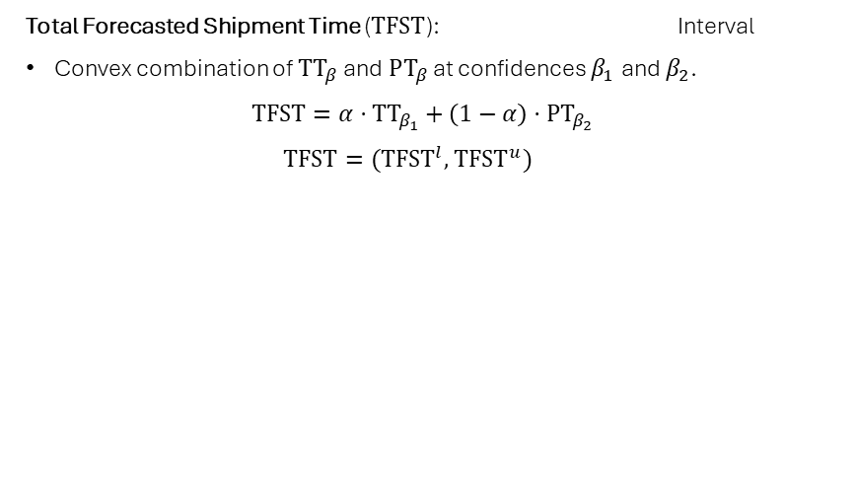
Realtime Indicators Definition (5)
Realtime indicators are statistical measures that provide actionable insights into the current state of the supply chain.
Organized hierarchically at different granularity levels, they combine:
Historical indicators.
Supply chain graph.
Real-time data.
Realtime indicators from lower levels.
Realtime Indicators
Path Level
Total Forecasted Shipment Time ($TFST$): Interval
Convex combination of $TT_{β}$and $PT_{β}$ at confidences $β_{1}$ and $β_{2}$.
$$TFST=α⋅TT_{β_{1}}+\left(1−α\right)⋅PT_{β_{2}}$$
$$TFST=(T{FST}^{l},T{FST}^{u})$$

Slide 27
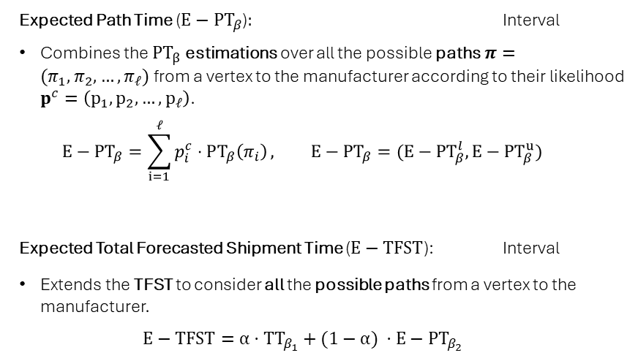
Realtime Indicators Definition (6)
Realtime indicators are statistical measures that provide actionable insights into the current state of the supply chain.
Organized hierarchically at different granularity levels, they combine:
Historical indicators.
Supply chain graph.
Real-time data.
Realtime indicators from lower levels.
Realtime Indicators
Graph Level
Expected Path Time (${E−PT}_{β}$)$:$ Interval
Combines the ${PT}_{β}$ estimations over all the possible paths $π=(π_{1},π_{2},…,π_{ℓ})$ from a vertex to the manufacturer according to their likelihood $p^{c}=\left(p_{1},p_{2},…,p_{ℓ}\right)$.
$${E−PT}_{β}=\sum_{i=1}^{ℓ}{p_{i}^{c}⋅PT_{β}\left(π_{i}\right)}, {E−PT}_{β}=({E−PT}_{β}^{l},{E−PT}_{β}^{u})$$
Expected Total Forecasted Shipment Time ($E−TFST$): Interval
Extends the TFST to consider all the possible paths from a vertex to the manufacturer.
$$E−TFST=α⋅{TT}_{β_{1}}+(1−α) ⋅{E−PT}_{β_{2}}$$

Slide 28
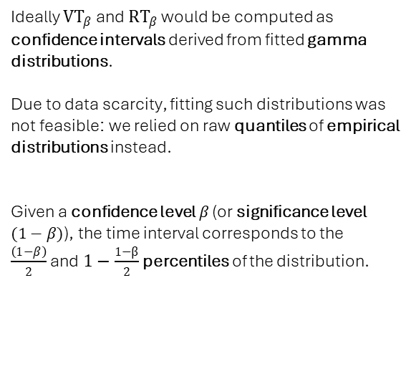
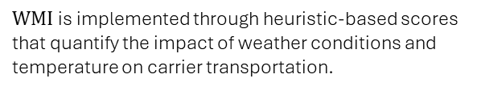
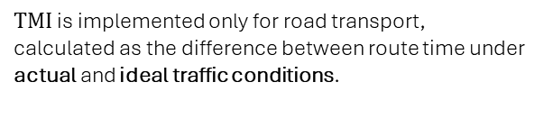
Realtime Indicators Implementation (1)
REALTIME INDICATORS
Vertex & Route Time
Traffic Meta Index
Ideally ${VT}_{β}$ and ${RT}_{β}$ would be computed as confidence intervals derived from fitted gamma distributions.
Due to data scarcity, fitting such distributions was not feasible: we relied on raw quantiles of empirical distributions instead.
Given a confidence level $β$ (or significance level $(1−β)$), the time interval corresponds to the
$\frac{\left(1−β\right)}{2}$ and $1−\frac{1−β}{2}$ percentiles of the distribution.
$TMI$ is implemented only for road transport, calculated as the difference between route time under actual and ideal traffic conditions.
Weather Meta Index
$WMI$is implemented through heuristic-based scores that quantify the impact of weather conditions and temperature on carrier transportation.

Slide 29
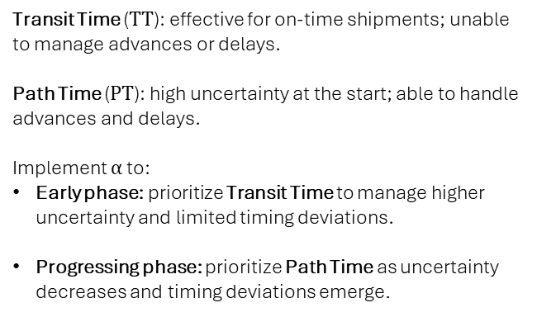
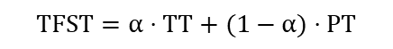
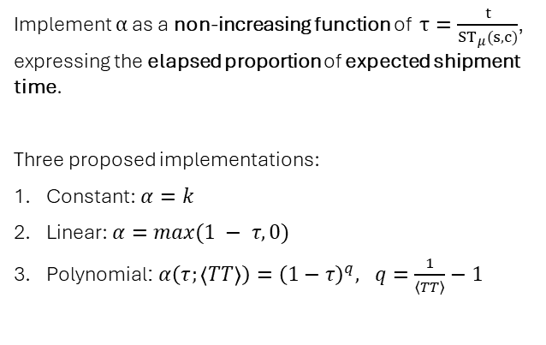
TFST Weighting Factor Implementation (1)
REALTIME INDICATORS
Objective
Solution
Transit Time ($TT$): effective for on-time shipments; unable to manage advances or delays.
Path Time ($PT$): high uncertainty at the start; able to handle advances and delays.
Implement $α$ to:
Early phase: prioritize Transit Time to manage higher uncertainty and limited timing deviations.
Progressing phase: prioritize Path Time as uncertainty decreases and timing deviations emerge.
Implement $α$ as a non-increasing function of $τ=\frac{t}{ST_{μ}(s, c)}$, expressing the elapsed proportion of expected shipment time.
Three proposed implementations:
Constant: $α=k$
Linear: $α=\max{(1 − τ,0)}$
Polynomial: $α\left(τ;\left\langle TT\right\rangle \right)={\left(1−τ\right)}^{q}, q=\frac{1}{\left\langle TT\right\rangle }−1$
$$TFST=α⋅TT+(1−α)⋅PT$$

Slide 30
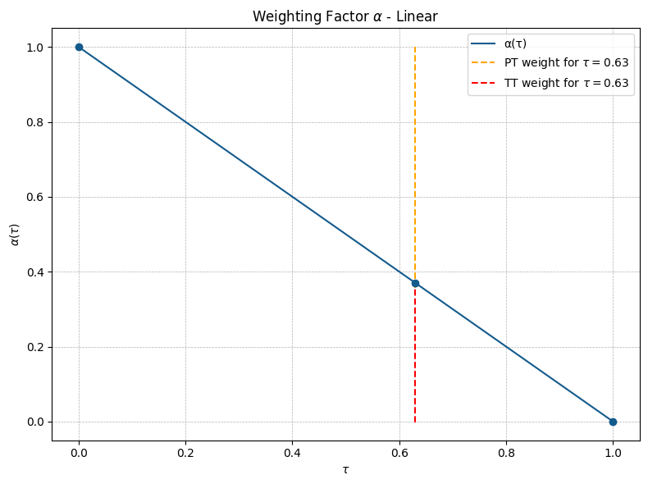

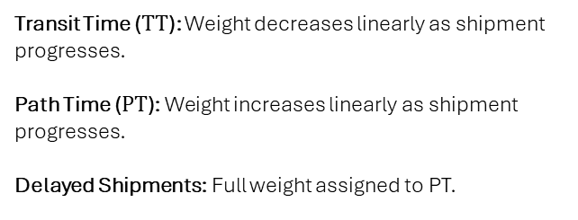
TFST Weighting Factor Implementation (2)
REALTIME INDICATORS
Linear Implementation
Transit Time ($TT$): Weight decreases linearly as shipment progresses.
Path Time ($PT$): Weight increases linearly as shipment progresses.
Delayed Shipments: Full weight assigned to PT.
$$α=\max{(1 − τ,0)}$$

Slide 31
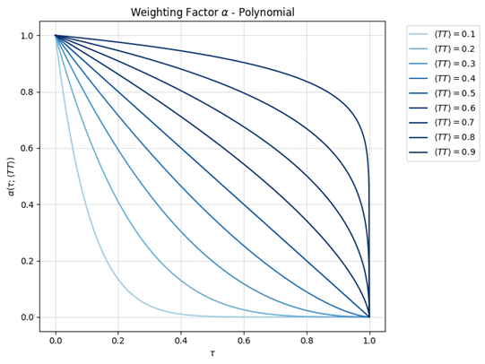
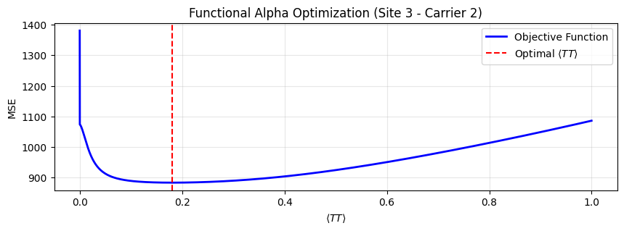
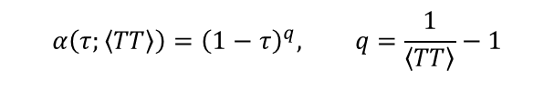
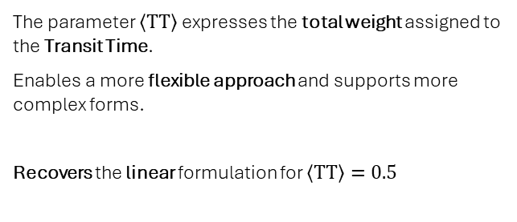
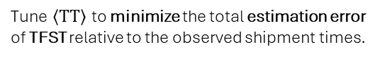
TFST Weighting Factor Implementation (3)
REALTIME INDICATORS
Polynomial Implementation
The parameter $〈TT〉$ expresses the total weight assigned to the Transit Time.
Enables a more flexible approach and supports more complex forms.
Recovers the linear formulation for $〈TT〉=0.5$
$$α\left(τ;\left\langle TT\right\rangle \right)={\left(1−τ\right)}^{q}, q=\frac{1}{\left\langle TT\right\rangle }−1$$
Tune $〈TT〉$ to minimize the total estimation error of TFST relative to the observed shipment times.

Slide 32
Protoype & Results

Slide 33
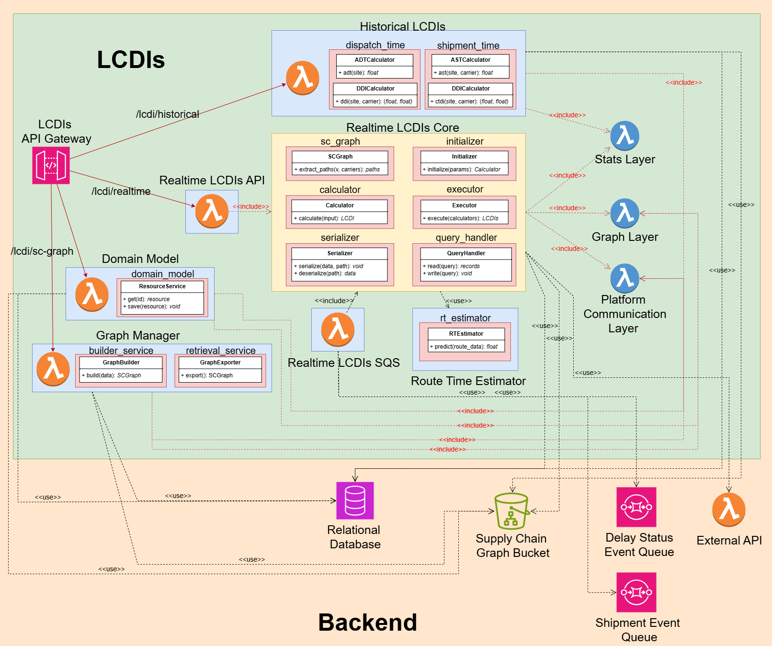
Prototype Architecture
Prototype & RESULTS
Implementation & Deployment
Developed in Python with deployment on AWS:
AWS Lambda Functions & Layers.
Amazon RDS (Relational Database Service).
Amazon S3 (Object Storage).
Amazon API Gateway.
Amazon SQS (Simple Queue Service).
Modularity & Configurability
Dynamic hyperparameter tuning via centralized configuration table.
Modular design enabling independent evolution of individual components.

Slide 34
Evaluation Methodology (1)
Evaluation focused on the system’s ability to accurately predict delivery time windows for orders, leveraging event data reported by carriers throughout the shipment process.
PROTOTYPE & Results
Estimations Time Resolution
Distributions fitted using hourly-resolution data; model evaluated at daily scale using two approaches:
Hourly-based: metrics computed from hourly predictions, then reported by day.
Daily-based: predictions discretized into business days, with metrics directly evaluated at this scale.
Operational Stages
Dispatch Stage: both dispatch time and shipment time must be estimated.
Shipment Stage: dispatch time already known; only shipment time is estimated.
Set splits
Training Set: used to fit the probability distributions.
Test Set: completely unseen during training, used solely for performance evaluation.

Slide 35
Evaluation Methodology (2)
Evaluation focused on the system’s ability to accurately predict delivery time windows for orders, leveraging event data reported by carriers throughout the shipment process.
PROTOTYPE & Results
Evaluation steps
Quantitative evaluation on three metrics:
Sharpness: width of predicted intervals.
Coverage: proportion of observations within the predicted interval.
Interval Score: single measure accounting for both sharpness and coverage.
Sensitivity Analysis: assessing model coverage across varying confidence levels.
Visualization of the evolution of shipment estimates.
Model Variants
Multiple implementations tested for realtime indicators.
Best-performing solution:
Polynomial version of the TFST weighting factor.
Baseline approach for DRT.

Slide 36
Quantitative Evaluation
Prototype & RESULTS
Operational Stage | Sharpness (days) |  | Coverage (%) |  | Interval Score (days)
 | Hourly | Daily | Hourly | Daily | Hourly | Daily
Dispatch | 2.15 | 2.20 | 0.28 | 0.56 | 4.22 | 4.26
Shipment | 1.03 | 1.18 | 0.52 | 0.84 | 1.45 | 1.63
Training Set – 90% Confidence
Operational Stage | Sharpness (days) |  | Coverage (%) |  | Interval Score (days)
 | Hourly | Daily | Hourly | Daily | Hourly | Daily
Dispatch | 2.87 | 3.00 | 0.3 | 0.5 | 7.81 | 7.44
Shipment | 1.30 | 1.55 | 0.63 | 0.86 | 1.99 | 2.20
Test Set – 90% Confidence

Slide 37
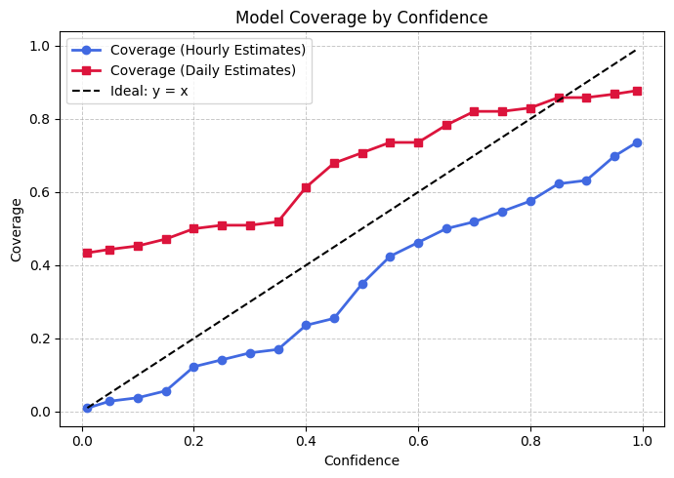
Sensitivity Analysis
Prototype & RESULTS
Evaluation
Coverage assessed on the test set across multiple nominal confidence levels.
Hour-resolution estimates show under-reliability.
Day-resolution estimates show over-reliability up to a nominal confidence of 0.85

Slide 38
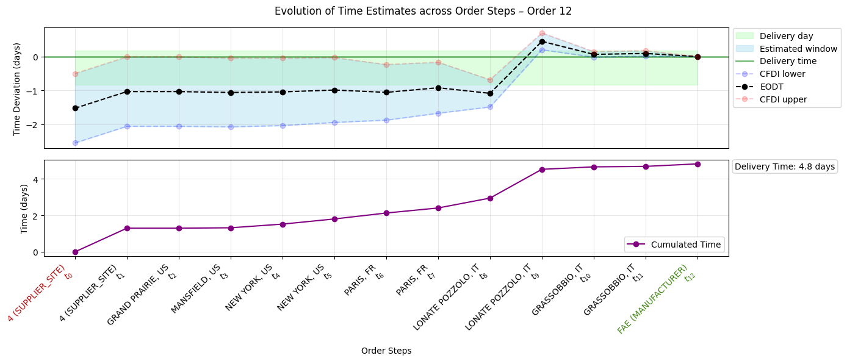
Evolution of Shipment Estimates (1)
Prototype & RESULTS

Slide 39
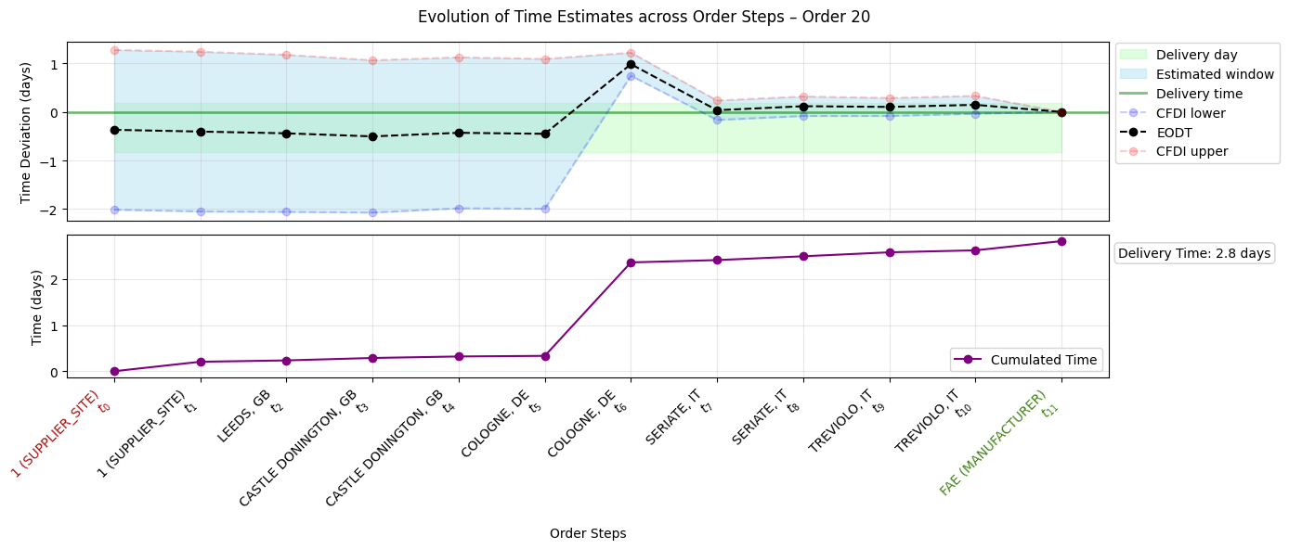
Evolution of Shipment Estimates (2)
Prototype & RESULTS

Slide 40
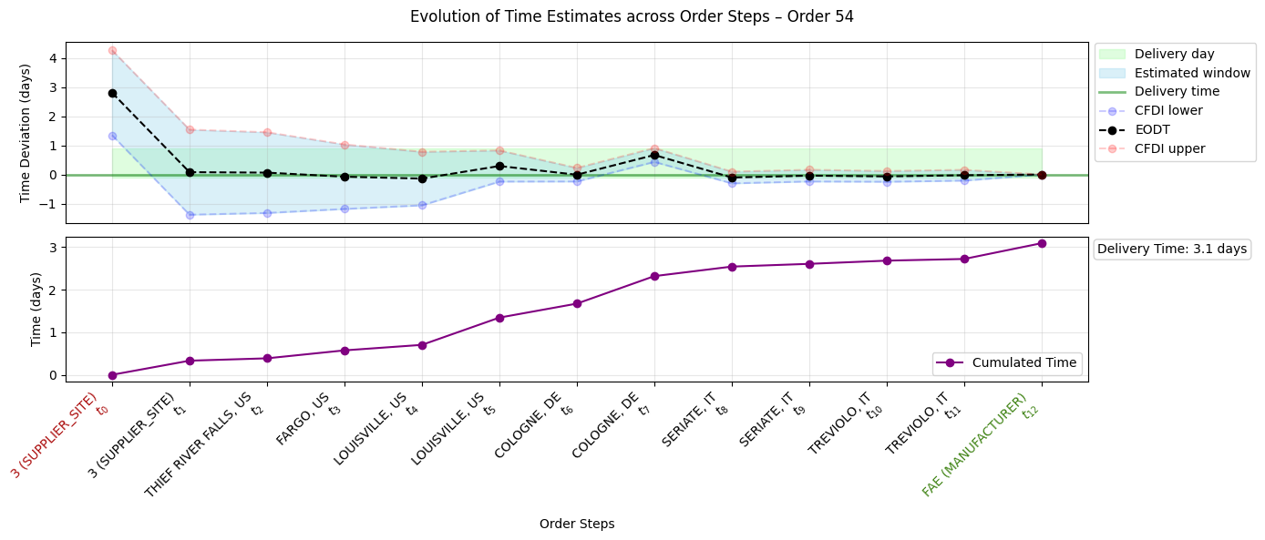
Evolution of Shipment Estimates (3)
Prototype & RESULTS

Slide 41
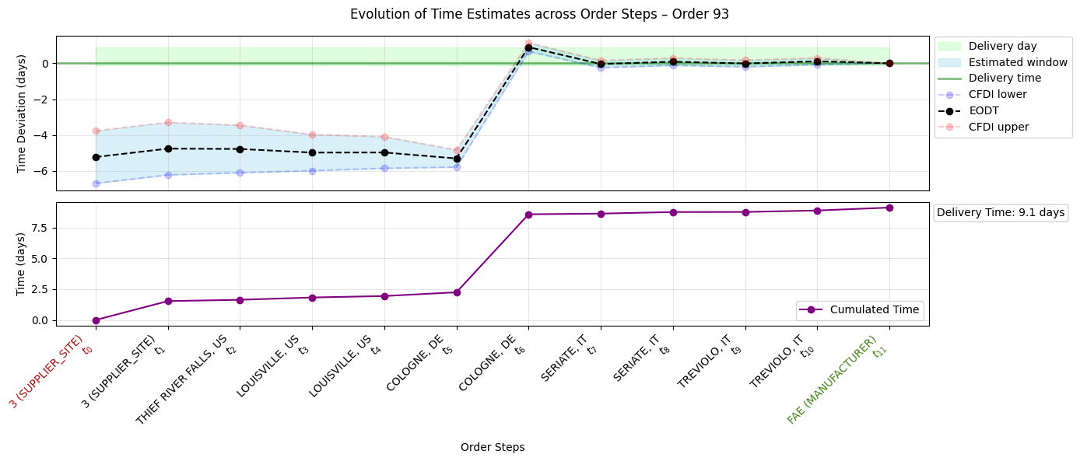
Evolution of Shipment Estimates (4)
Prototype & RESULTS

Slide 42
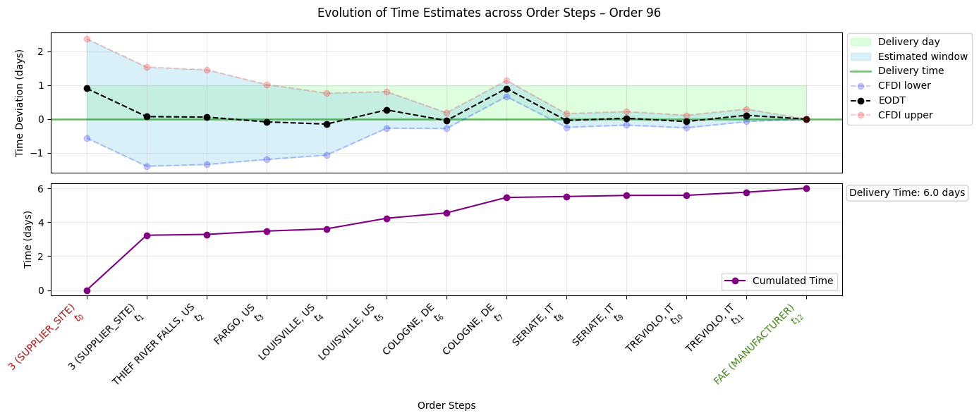
Evolution of Shipment Estimates (5)
Prototype & RESULTS

Slide 43
Conclusion

Slide 44
Key Findings
Overall calibration shows some under-reliability, particularly at higher confidence levels; nevertheless, even with limited data the framework already enables effective disruption detection.
conclusion
Real-Time Delay Detection
The system detects disruptions in real time as shipment events are received, fully meeting the project’s core requirements.
Time Resolution Trade-off
Hourly estimates offer finer resolution but lower reliability; daily estimates are better calibrated for practical use.
Operational Stage
Dispatch stage estimates remain unreliable; shipment stage provides actionable insights as uncertainty decreases, even with the limited amount of data available.

Slide 45
Future Developments
Future development should focus on acquiring more data to improve calibration and support the implantation of more sophisticated, formally defined solutions for specific indicators.
conclusion
Data Expansion
Expand the dataset and refine all data-driven components, such as probability distributions, to improve calibration, enhance indicators, and increase the reliability of predictions.
Refinement of Indicators Implementation
Implement and validate more advanced solutions for specific indicators, in particular DRT (e.g., Bayesian methods, quantile regression).
Multi-Manufacturer Extension
Extend framework to support multiple manufacturers and more complex operational contexts.

Slide 46
References
CONCLUSION
L. R. Ford and D. R. Fulkerson, “Maximal flow through a network,” Canadian Journal of Mathematics, vol. 8, no. 3, pp. 399–404, 1956.
J. R. Norris, Markov Chains. Cambridge University Press, 1998.
G. Grimmett and D. Stirzaker, Probability and Random Processes, 3rd.Oxford University Press, 2001.
A. V. Hill, J. M. Hays, and E. Naveh, “A model for optimal delivery time guarantees,” Journal of service research, vol. 2, no. 3, pp. 254–264, 2000
T. Gneiting and A. E. Raftery, “Strictly proper scoring rules, prediction and estimation,” Journal of the American Statistical Association, vol. 102,no. 477, pp. 359–378, 2007.
Y. Huang, A. Bárdossy, and K. Zhang, “Sensitivity of hydrological models to temporal and spatial resolutions of rainfall data,” Hydrology and Earth System Sciences, vol. 23, no. 6, pp. 2647–2663, 2019.

